Slide 1
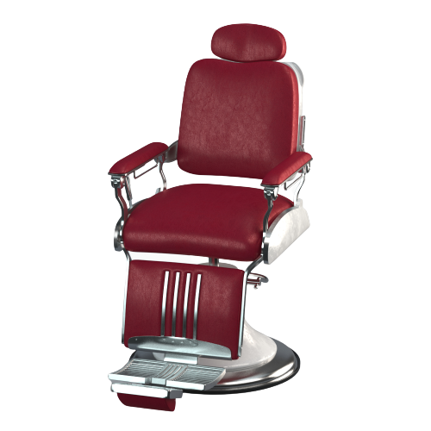
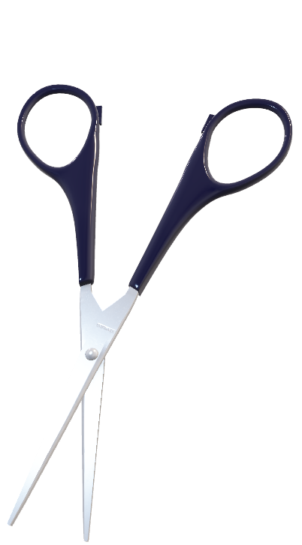
Online hair cut booking system
www.bookbarber.com

Slide 2

Submitted by
Darshit Sojitra
Vihar Talaviya
Jaimin Gajera
Rutvik Taraviya
Kadi Sarva Vishwavidyalaya
LDRP institute of technology& Research, Gandhinagar
Computer Engineering department
August-2022

Slide 3

Agenda
Problem statement
Survey
Solution Model
Features of the model
Features of the website
Proof of work

Slide 4

Problem statement
Have you ever waited so long in a queue to get a hair cut in barber shop ?
It is most unused time we spent doing nothing…

Slide 5
In India there are 730 million men among which 25.78% are teenagers (0 to 14 years old)
Among total population
67.45% are 15 to 64 years old.

Slide 6
Every men spends 80-90 minutes in a barber shop
avg. 6 times/year.
In 80-90 minutes 24-30 minutes are
spent in waiting in queue

Slide 7

solution
A one stop website for a men’s grooming .
Online slot booking.
Select your saloon with best rating.
Get a list of available shop nearby.

Slide 8

In hurry !! No problem.
Get probable hair cutting time while booking slot.
Centralized platform for local barbers.
Get a full profile of the shop and shop owner.
Contact number , location and 3D view of the shop.

Slide 9




All modes of payments are acceptable.
Notification of free slot availability.
Filter out according to your choice.
Royalty points for each booking.
Redeemable on each 6th booking.
Exciting discount on festive season.

Slide 10
Features of website
Map based UI to find nearby area.
Slot availability.
Check availability
Already Waiting customers
Booked slot
Next probable slot

Slide 11


Option for favourite shop (Bookmark).
Appointment for specific barber.
Book slot by paying small amount of token charges.
Valid for 10 minutes (No refund)
Fixed price according to association according to area.

Slide 12


Payment Gateway
Online
Offline
Customer review portal for shop ratings.
Based on Barber’s behavior.
Hygiene
Overall service.

Slide 13


Other features
OTP verification while payment.
Guaranteed discounts on payment through in-built wallet.
Category wise charges (kids, adults, senior - citizen)

Slide 14
Filter option to select from
AC / Non AC shops
Slot availability
Price filter
Distance (From your current location to shop)
Shop rating
Average time for haircutting (based on past records)
Open close time.

Slide 15
Proof of work
Visit
<Website link>

Slide 16
Thank you….

